Slide 1
Advanced Dungeons and Testing Dragons
Temple of the Golden Cobra

Slide 2
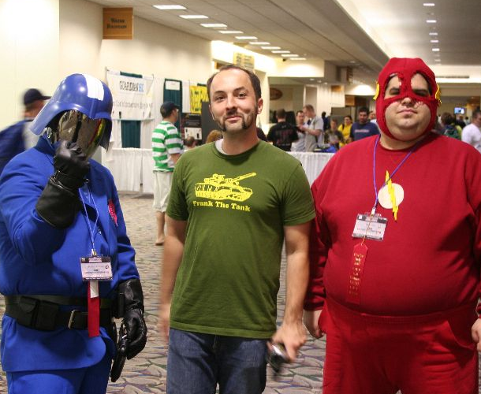
Franklin Webber
Training and Technical Content Lead
US Army - Radio/COMSEC Repairer (35E)
Tech Support
Quality Assurance
Software Developer Eng. in Test
Software Developer
Instructor / Trainer
Notes:
Before we start let me introduce myself.

Slide 3
Dan
"Two Swords" Robinson
Eric
"BB / LG" Maxwell
Kimball
"Magic Missile" Johnson
Tyler
"Cure Light Wounds"
Fitch

Slide 4
You
Level 4-6 Chef Cookbook Author
High Charisma
Understand Chef Resources, Cookbooks, and Cookbook dependencies
Understanding testing basics (i.e. ChefSpec and the RSpec command)
Notes:
Let me tell who I think you are and for whom this content has been designed.

Slide 5
Introduce Yourself

Slide 6
Schedule
9:00 - 9:30 – Introductions
9:30 - 10:15 – Finding the Ark
10:15 - 10:30 – BREAK
10:30 - 11:15 – Unraveling the Power of the Ark
11:15 - 11:30 – BREAK
11:30 - 12:15 – The Ark's Power Realized
12:15 - 13:45 – LUNCH (90 minutes)
Notes:
This is the general schedule of the presentation.

Slide 7
Schedule
12:15 - 13:45 – LUNCH (90 minutes)
13:45 - 14:15 – The Python's Scales
14:15 - 14:30 – BREAK
14:30 - 15:15 – Challenging the Golden Cobra
15:15 - 15:30 – BREAK
15:30 - 16:15 – Securing the Power of the Ark
16:15 - 16:30 – GOODBYES
Notes:
This is the general schedule of the presentation.

Slide 8
Advanced Dungeons and Testing Dragons
Temple of the Golden Cobra

Slide 9
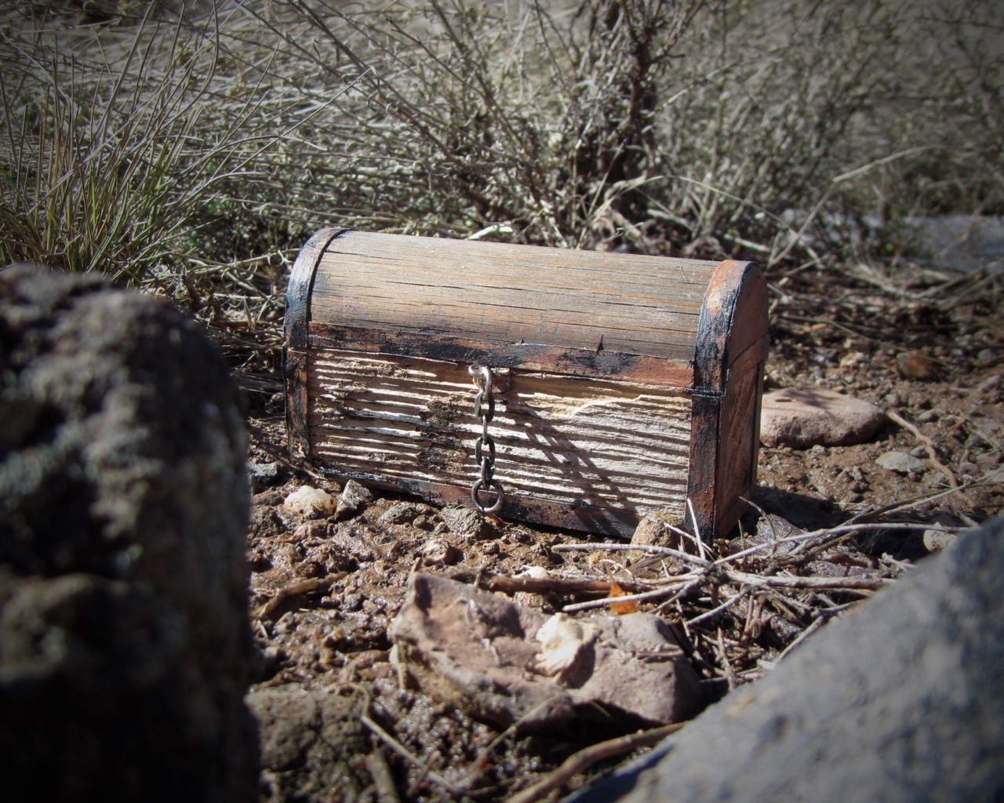
Finding the Ark
The Story so Far
The Encounter
Concepts
Exercise
Review
Notes:
davidd @ https://flic.kr/p/DyTeW1

Slide 11
Finding the Ark
The Story so Far
The Encounter
Concepts
Exercise
Review

Slide 13
Finding the Ark
The Story so Far
The Encounter
Concepts
Exercise
Review

Slide 14
Power Word: let
Use let to define a memoized helper method. The value will be cached
across multiple calls in the same example but not across examples.
Note that let is lazy-evaluated: it is not evaluated until the first time
the method it defines is invoked. You can use let! to force the method's
invocation before each example.

Slide 15
Diagramming the let Helper Method
describe 'ark::default' do
context 'when no attributes are ...
let(:chef_run) do
runner = ChefSpec::SoloRunner.new
runner.converge(described_recipe)
runner
end
it 'installs necessary packages' do
expect(chef_run).to install_p...
expect(chef_run).to install_p...
end
it "does not install the gcc-c+...
expect(chef_run).not_to insta...
end
let is a RSpec helper method
Ruby Symbol
Code Block
Invocation

Slide 16
Invoking the Helper Method
describe 'ark::default' do
context 'when no attributes are ...
let(:chef_run) do
runner = ChefSpec::SoloRunner.new
runner.converge(described_recipe)
runner
end
it 'installs necessary packages' do
expect(chef_run).to install_p...
expect(chef_run).to install_p...
end
it "does not install the gcc-c+...
expect(chef_run).not_to insta...
end
chef_run sends a message
RSpec invokes the contents of the block
RSpec stores the contents of the execution
chef_run sends a message
RSpec retrieves the stored execution

Slide 17
Cached Within each Example
describe 'ark::default' do
context 'when no attributes are ...
let(:chef_run) do
runner = ChefSpec::SoloRunner.new
runner.converge(described_recipe)
runner
end
it 'installs necessary packages' do
expect(chef_run).to install_p...
expect(chef_run).to install_p...
end
it "does not install the gcc-c+...
expect(chef_run).not_to insta...
end
chef_run is loaded and stored
chef_run uses the stored invocation
chef_run is loaded and stored

Slide 18
A chef_run with Node Attributes
describe 'ark::default' do
context 'when no attributes are specified, on CentOS' do
let(:chef_run) do
runner = ChefSpec::SoloRunner.new({ platform: 'centos',
version: '6.7' })
runner.converge(described_recipe)
end
# ... EXAMPLES WITHIN CONTEXT
end
end

Slide 19
Using let to Create Clearer Examples
describe 'ark::default' do
context 'when no attributes are specified, on CentOS' do
let(:chef_run) do
runner = ChefSpec::SoloRunner.new(node_attributes)
runner.converge(described_recipe)
end
let(:node_attributes) do
{ platform: 'centos', version: '6.7' }
end
# ... EXAMPLES WITHIN CONTEXT
end

Slide 20
A let for each Context
describe 'ark::default' do
context 'when no attributes are specified, on an unspe...orm' do
let(:chef_run) do
runner = ChefSpec::SoloRunner.new
runner.converge(described_recipe)
end
# ... EXAMPLES WITHIN CONTEXT
end
context 'when no attributes are specified, on CentOS' do
let(:chef_run) do
runner = ChefSpec::SoloRunner.new(platform: 'centos', version: ...)
runner.converge(described_recipe)
end
# ... EXAMPLES WITHIN CONTEXT

Slide 21
Overriding a let in a Child Context
describe 'ark::default' do
let(:chef_run) do
runner = ChefSpec::SoloRunner.new(node_attributes)
runner.converge(described_recipe)
end
let(:node_attributes) do
{}
end
context 'when no attributes are specified, on an unspecif...orm' do
# ... EXAMPLES WITHIN CONTEXT
end
context 'when no attributes are specified, on CentOS' do
let(:node_attributes) do
{ platform: 'centos', version: '6.7' }
end
# ... EXAMPLES WITHIN CONTEXT

Slide 22
Conjure shared_examples
Shared examples let you describe behavior of classes or modules. When declared, a shared group's content is stored. It is only realized in the context of another example group, which provides any context the shared group needs to run.

Slide 23
Finding the Ark
The Story so Far
The Encounter
Concepts
Exercise
Review

Slide 24
Exercise
Refactor the the Ark's default recipe specification using:
Power Word: let
Conjure: shared_examples
Run `chef exec rspec spec/recipes/default_spec.rb` to ensure the examples pass

Slide 25
Finding the Ark
The Story so Far
The Encounter
Concepts
Exercise
Review

Slide 26
Change in to the Cookbook Directory
> cd ~/ark

Slide 27
Execute the Test Suite
> chef exec rspec spec/recipes/default_spec.rb
...................
Finished in 3.58 seconds (files took 2.73 seconds to load)
19 examples, 0 failures
ChefSpec Coverage report generated...
Total Resources: 41
Touched Resources: 41
Touch Coverage: 100.0%

Slide 28
Edit the Recipe Specification File
~/ark/spec/recipes/default_spec.rb
require 'spec_helper'
describe 'ark::default' do
context 'when no attributes are specified, on an unspecified platform' do
let(:chef_run) do
runner = ChefSpec::SoloRunner.new
runner.converge(described_recipe)
end
it 'installs necessary packages' do

Slide 29
Live Demonstration

Slide 30
Finding the Ark
The Story so Far
The Encounter
Concepts
Exercise
Review

Slide 32

Unraveling the Power of the Ark
Introduction
The Encounter
Concepts
Exercise
Review
Notes:
Jeferson Carlos @ https://flic.kr/p/f7KDsW

Slide 34
Unraveling the Power of the Ark
Introduction
The Encounter
Concepts
Exercise
Review

Slide 36
Unraveling the Power of the Ark
Introduction
The Encounter
Concepts
Exercise
Review

Slide 37
Prismatic require

Slide 38
Ray of shared_context

Slide 39
alias

Slide 40
Unraveling the Power of the Ark
Introduction
The Encounter
Concepts
Exercise
Review

Slide 41
Exercise
Continue to refactor the the Ark's default recipe specification using:
Power Word: let
Conjure shared_examples
Prismatic require
Ray of shared_context
alias
Run `chef exec rspec spec/recipes/default_spec.rb` to ensure the examples pass

Slide 42
Unraveling the Power of the Ark
Introduction
The Encounter
Concepts
Exercise
Review

Slide 43
Change in to the Cookbook Directory
> cd ~/ark

Slide 44
Execute the Test Suite
> chef exec rspec spec/recipes/default_spec.rb
...................
Finished in 3.58 seconds (files took 2.73 seconds to load)
19 examples, 0 failures
ChefSpec Coverage report generated...
Total Resources: 41
Touched Resources: 41
Touch Coverage: 100.0%

Slide 45
Edit the Recipe Specification File
~/ark/spec/recipes/default_spec.rb
require 'spec_helper'
describe 'ark::default' do
context 'when no attributes are specified, on an unspecified platform' do
let(:chef_run) do
runner = ChefSpec::SoloRunner.new
runner.converge(described_recipe)
end
it 'installs necessary packages' do

Slide 46
Live Demonstration

Slide 47
Unraveling the Power of the Ark
Introduction
The Encounter
Concepts
Exercise
Review

Slide 49

The Ark's Power Realized
Introduction
The Encounter
Concepts
Exercise
Review
Notes:
Nullfy from Nullfy.com! @ https://flic.kr/p/qC7Qhn

Slide 51
The Ark's Power Realized
Introduction
The Encounter
Concepts
Exercise
Review
Notes:
Nullfy from Nullfy.com! @ https://flic.kr/p/qC7Qhn

Slide 53
The Ark's Power Realized
Introduction
The Encounter
Concepts
Exercise
Review
Notes:
Nullfy from Nullfy.com! @ https://flic.kr/p/qC7Qhn

Slide 54
Fixture Cookbook

Slide 55
Defining ChefSpec Matchers

Slide 56
ChefSpec's step_into

Slide 57
The Ark's Power Realized
Introduction
The Encounter
Concepts
Exercise
Review
Notes:
Nullfy from Nullfy.com! @ https://flic.kr/p/qC7Qhn

Slide 58
Exercise
Define the 'install_with_make' example
Run `chef exec rspec spec/resources/default_spec.rb:57` to ensure the example passes

Slide 59
The Ark's Power Realized
Introduction
The Encounter
Concepts
Exercise
Review
Notes:
Nullfy from Nullfy.com! @ https://flic.kr/p/qC7Qhn

Slide 60
Change in to the Cookbook Directory
> cd ~/ark

Slide 61
Execute the Test Suite
> chef exec rspec spec/resources/default_spec.rb:57

Slide 62
Edit the Resource Specification File
~/ark/spec/resources/default_spec.rb

Slide 63
Live Demonstration

Slide 64
The Ark's Power Realized
Introduction
The Encounter
Concepts
Exercise
Review
Notes:
Nullfy from Nullfy.com! @ https://flic.kr/p/qC7Qhn

Slide 66
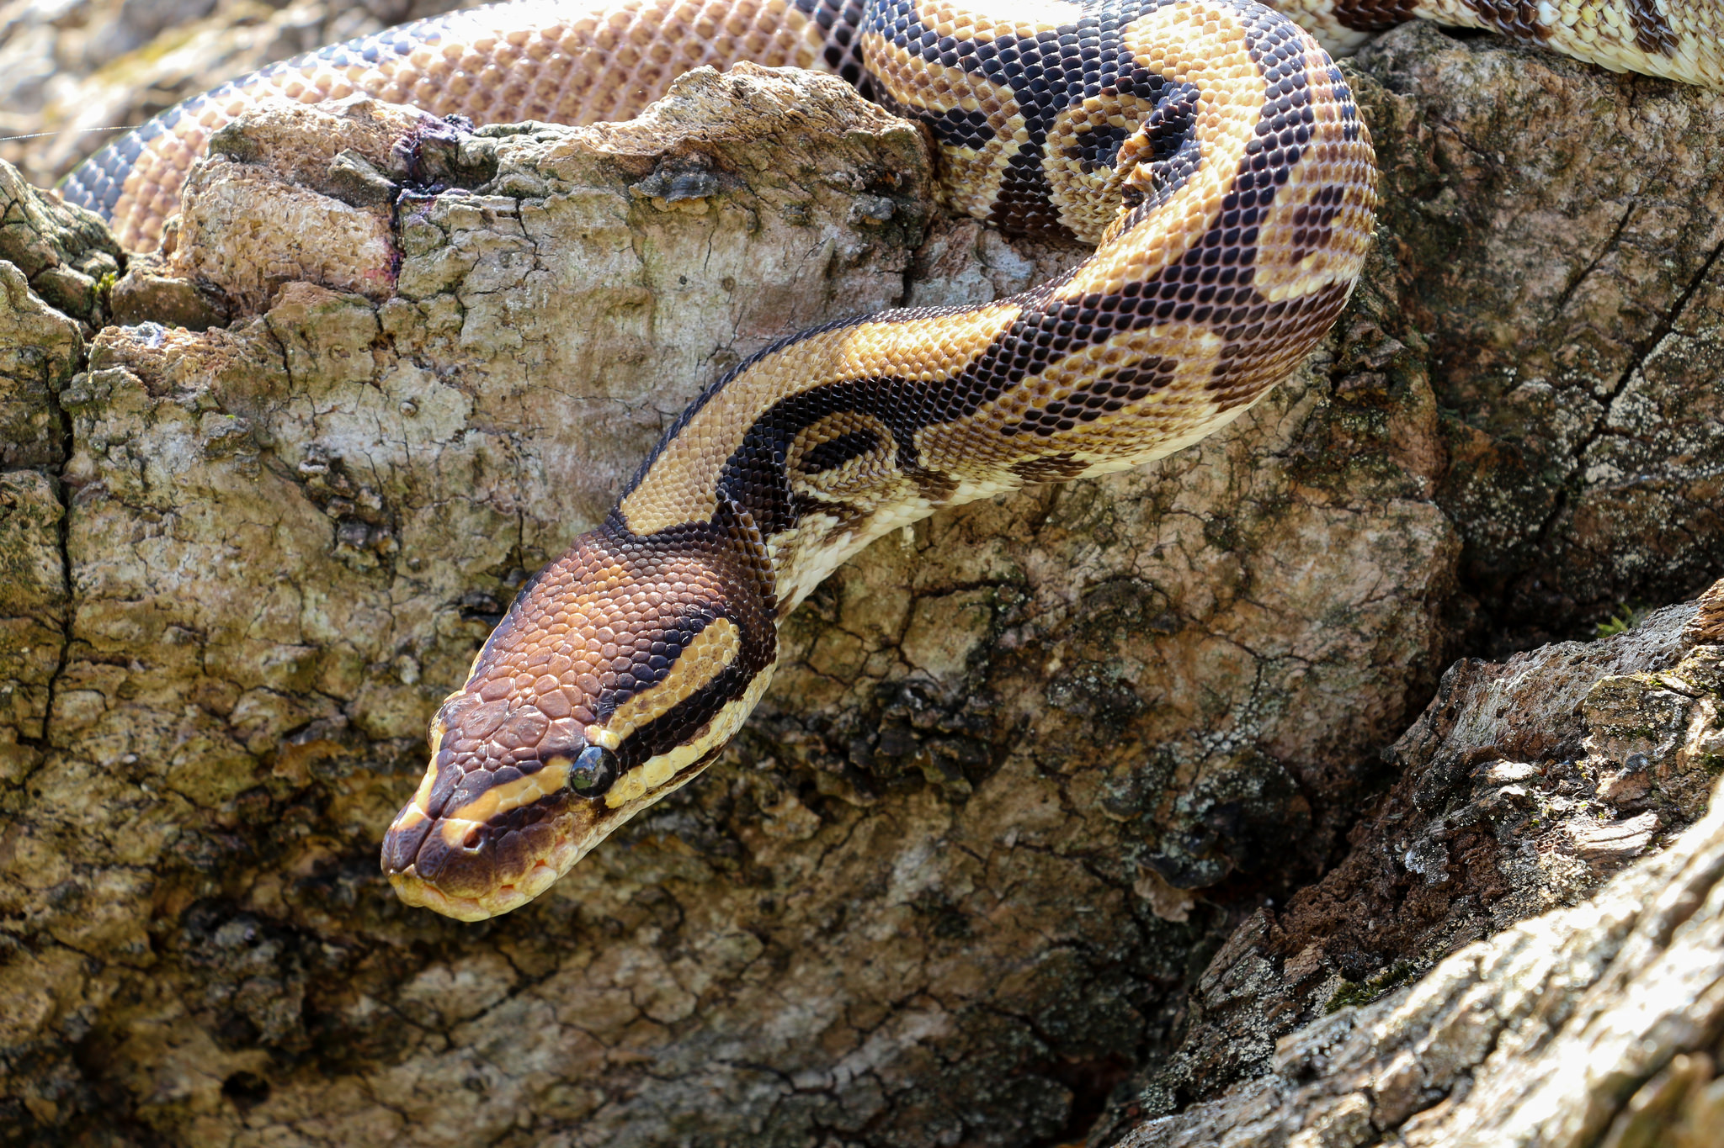
The Python's Scales
Introduction
The Encounter
Concepts
Exercise
Review
Notes:
Chris Parker @ https://flic.kr/p/oLXRTD

Slide 68
The Python's Scales
Introduction
The Encounter
Concepts
Exercise
Review
Notes:
Chris Parker @ https://flic.kr/p/oLXRTD

Slide 70
The Python's Scales
Introduction
The Encounter
Concepts
Exercise
Review
Notes:
Chris Parker @ https://flic.kr/p/oLXRTD

Slide 71
Custom Resource

Slide 72
Custom Resource: actions

Slide 73
Custom Resource: action

Slide 74
Custom Resource: properties

Slide 75
The Python's Scales
Introduction
The Encounter
Concepts
Exercise
Review
Notes:
Chris Parker @ https://flic.kr/p/oLXRTD

Slide 76
Exercise

Slide 77
The Python's Scales
Introduction
The Encounter
Concepts
Exercise
Review
Notes:
Chris Parker @ https://flic.kr/p/oLXRTD

Slide 78
Live Demonstration

Slide 79
The Python's Scales
Introduction
The Encounter
Concepts
Exercise
Review
Notes:
Chris Parker @ https://flic.kr/p/oLXRTD

Slide 81
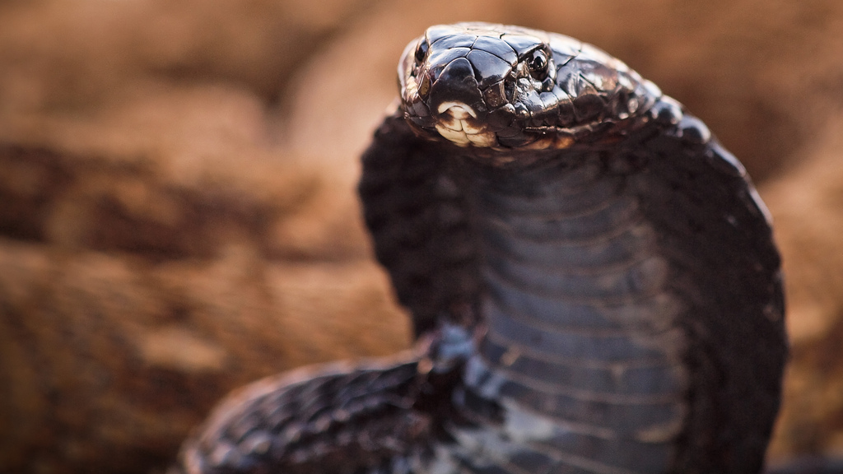
Challenging the Golden Cobra
Introduction
The Encounter
Concepts
Exercise
Review
Notes:
Luca Boldrini @ https://flic.kr/p/7wo8dk

Slide 83
Challenging the Golden Cobra
Introduction
The Encounter
Concepts
Exercise
Review
Notes:
Luca Boldrini @ https://flic.kr/p/7wo8dk

Slide 85
Challenging the Golden Cobra
Introduction
The Encounter
Concepts
Exercise
Review
Notes:
Luca Boldrini @ https://flic.kr/p/7wo8dk

Slide 87
Challenging the Golden Cobra
Introduction
The Encounter
Concepts
Exercise
Review
Notes:
Luca Boldrini @ https://flic.kr/p/7wo8dk

Slide 88
Exercise

Slide 89
Challenging the Golden Cobra
Introduction
The Encounter
Concepts
Exercise
Review
Notes:
Luca Boldrini @ https://flic.kr/p/7wo8dk

Slide 90
Live Demonstration

Slide 91
Challenging the Golden Cobra
Introduction
The Encounter
Concepts
Exercise
Review
Notes:
Luca Boldrini @ https://flic.kr/p/7wo8dk

Slide 93

Securing the Power of the Ark
Introduction
The Encounter
Concepts
Exercise
Review
Notes:
Andrea Kirby @ https://flic.kr/p/9h1bLJ

Slide 95
Securing the Power of the Ark
Introduction
The Encounter
Concepts
Exercise
Review
Notes:
Andrea Kirby @ https://flic.kr/p/9h1bLJ

Slide 97
Securing the Power of the Ark
Introduction
The Encounter
Concepts
Exercise
Review
Notes:
Andrea Kirby @ https://flic.kr/p/9h1bLJ

Slide 98
Helper Methods

Slide 99
Include in a Class

Slide 100
Stub and Mock

Slide 101
Securing the Power of the Ark
Introduction
The Encounter
Concepts
Exercise
Review
Notes:
Andrea Kirby @ https://flic.kr/p/9h1bLJ

Slide 102
Exercise

Slide 103
Securing the Power of the Ark
Introduction
The Encounter
Concepts
Exercise
Review
Notes:
Andrea Kirby @ https://flic.kr/p/9h1bLJ

Slide 104
Live Demonstration

Slide 105
Securing the Power of the Ark
Introduction
The Encounter
Concepts
Exercise
Review
Notes:
Andrea Kirby @ https://flic.kr/p/9h1bLJ

